Slide 1

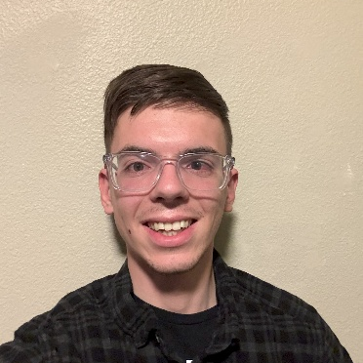
Clever Coyotes
Kaden’s User Manual
Made by Kaden
The User manual | 01/21/2025

Slide 2
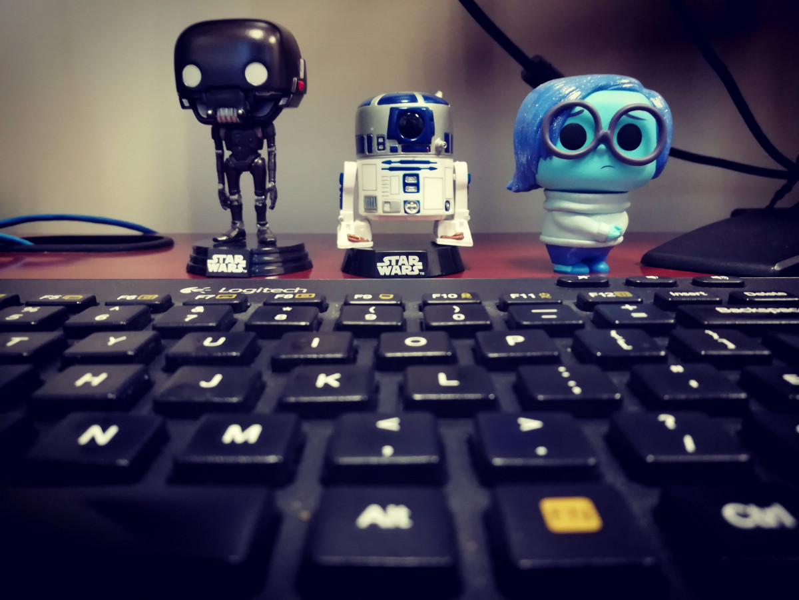
Conditions I like to work in
Working Environment Preferences I like a quiet working environment, as well as a busier environment. I find it hard to do work that requires my concentration if there is a lot of people watching.
Workspace Preference I like having my own desk space to place my things
If Headphones… If I have my headphones on, I am bored or watching a video, so please do disturb me!
[OPTIONAL IMAGE / GIF HERE]

Slide 3
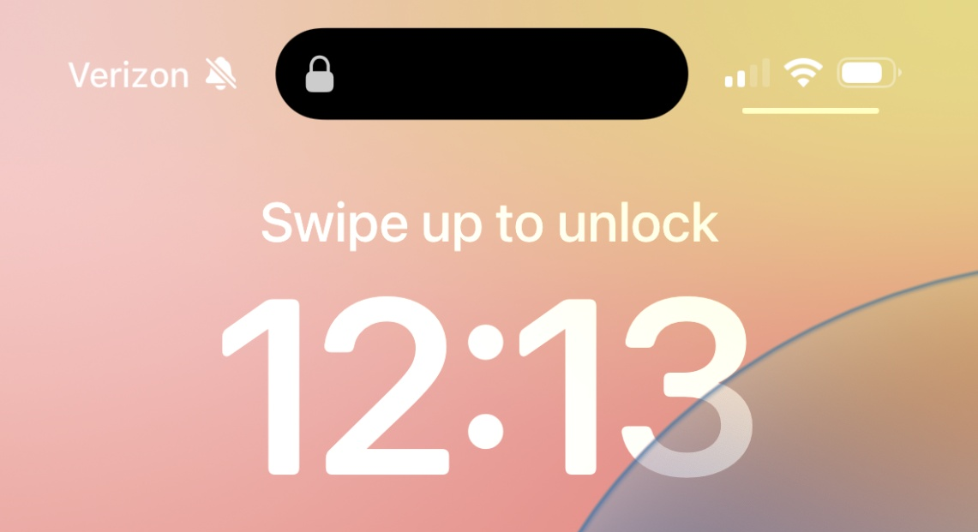
Times / hours I like to work
Start Time Preference I am trying to start my work day at 7:30 am since I am more productive early in the day, and can be home in the afternoon for activities
Productivity time I work best in the morning/afternoon
Times of Contact I don't mind being contacted at any time by message, but if outside of work hours I may not respond right away.
My Calendar My calendar is open and accessible so everyone can see my availability. I don't mind people booking things in my calendar if I am free, however I do like a heads up and reminder about events
continue
[OPTIONAL IMAGE / GIF HERE]

Slide 4
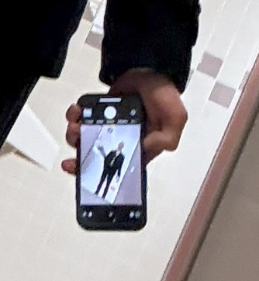
Best ways to communicate with me
Cellphone Phone call is the quickest way to get a response from me, but is more for urgent matters. I check messages every day, and respond when possible. Emojis are fun and increase my response speed.
Email I try to check my emails once a day and usually respond within 48 hours at the latest, but sending a message reminder is appreciated.
Sensitive Topics Sensitive topics may be best communicated in person, to prevent misinterpretations. I am always open to chat, or we can video chat, just give me a heads up.
[OPTIONAL IMAGE / GIF HERE]

Slide 5
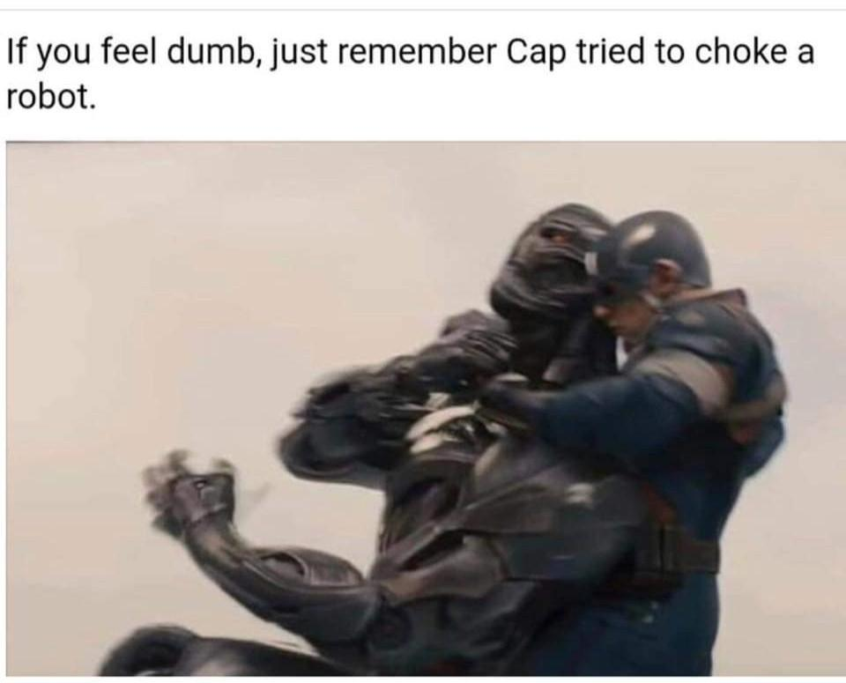
How I best receive feedback
How Much Feedback I would appreciate difficult conversations than things be unspoken or inauthentic. Most of the time I simply do not know what I am doing wrong, and knowing will allow me to do better.
Deliverance Method I like receiving feedback in person, and if possible, privately.
Opinion on feedback All feedback is a learning opportunity to learn, so any feedback that includes specific examples and/or suggestions on how I / it could be better/different is welcomed
When not to give feedback Timely feedback is extremely helpful so that less mistakes will be made. However, it should be done when level-headed.

Slide 6
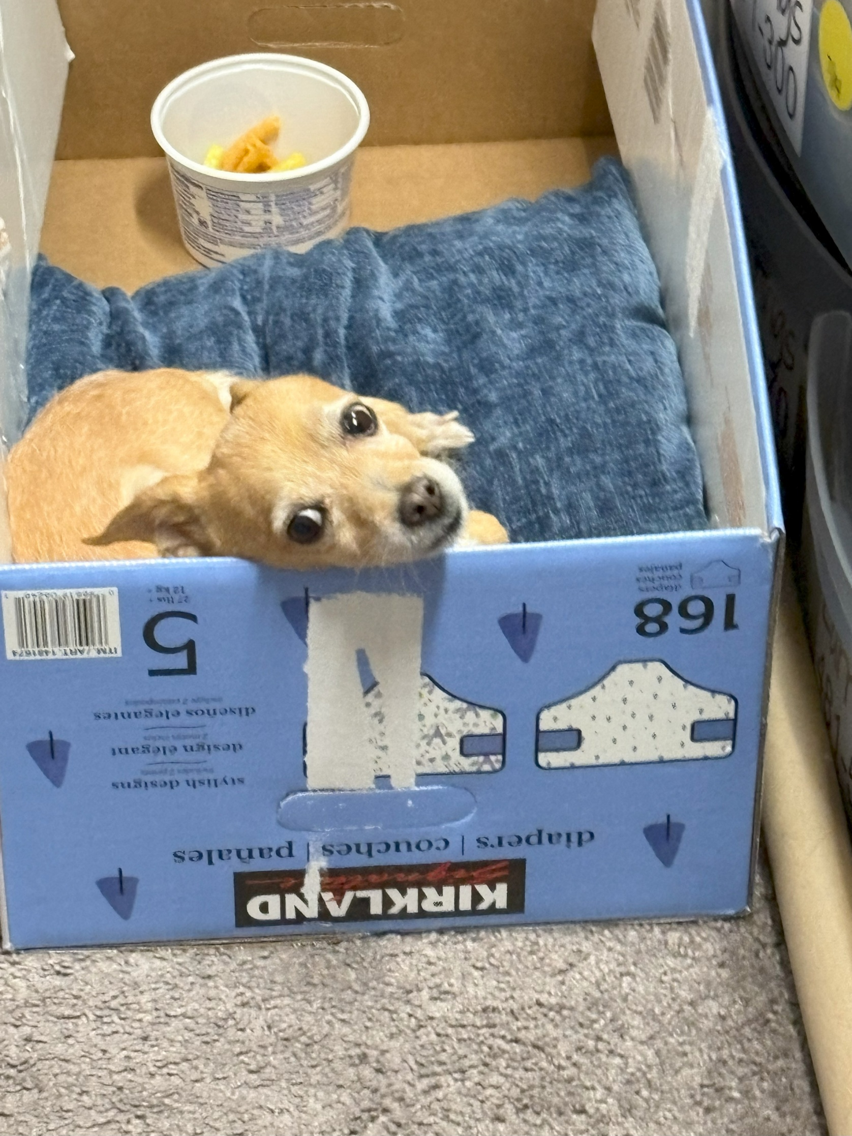
Things I need
Space Outs I take time to reflect. If I’m spaced out, no offense to the speaker, I am in deep though – gathering ideas about what was discussed or planning the next step.
Brain Stops I enjoy the opportunity to take a couple of brain-breaks during the day. Taking a breather allows me to stay more focused while working.
Munching I need constant food in my life. I just need something to snack on, to be less sidetracked.
[OPTIONAL IMAGE / GIF HERE]
Down Time

Slide 7
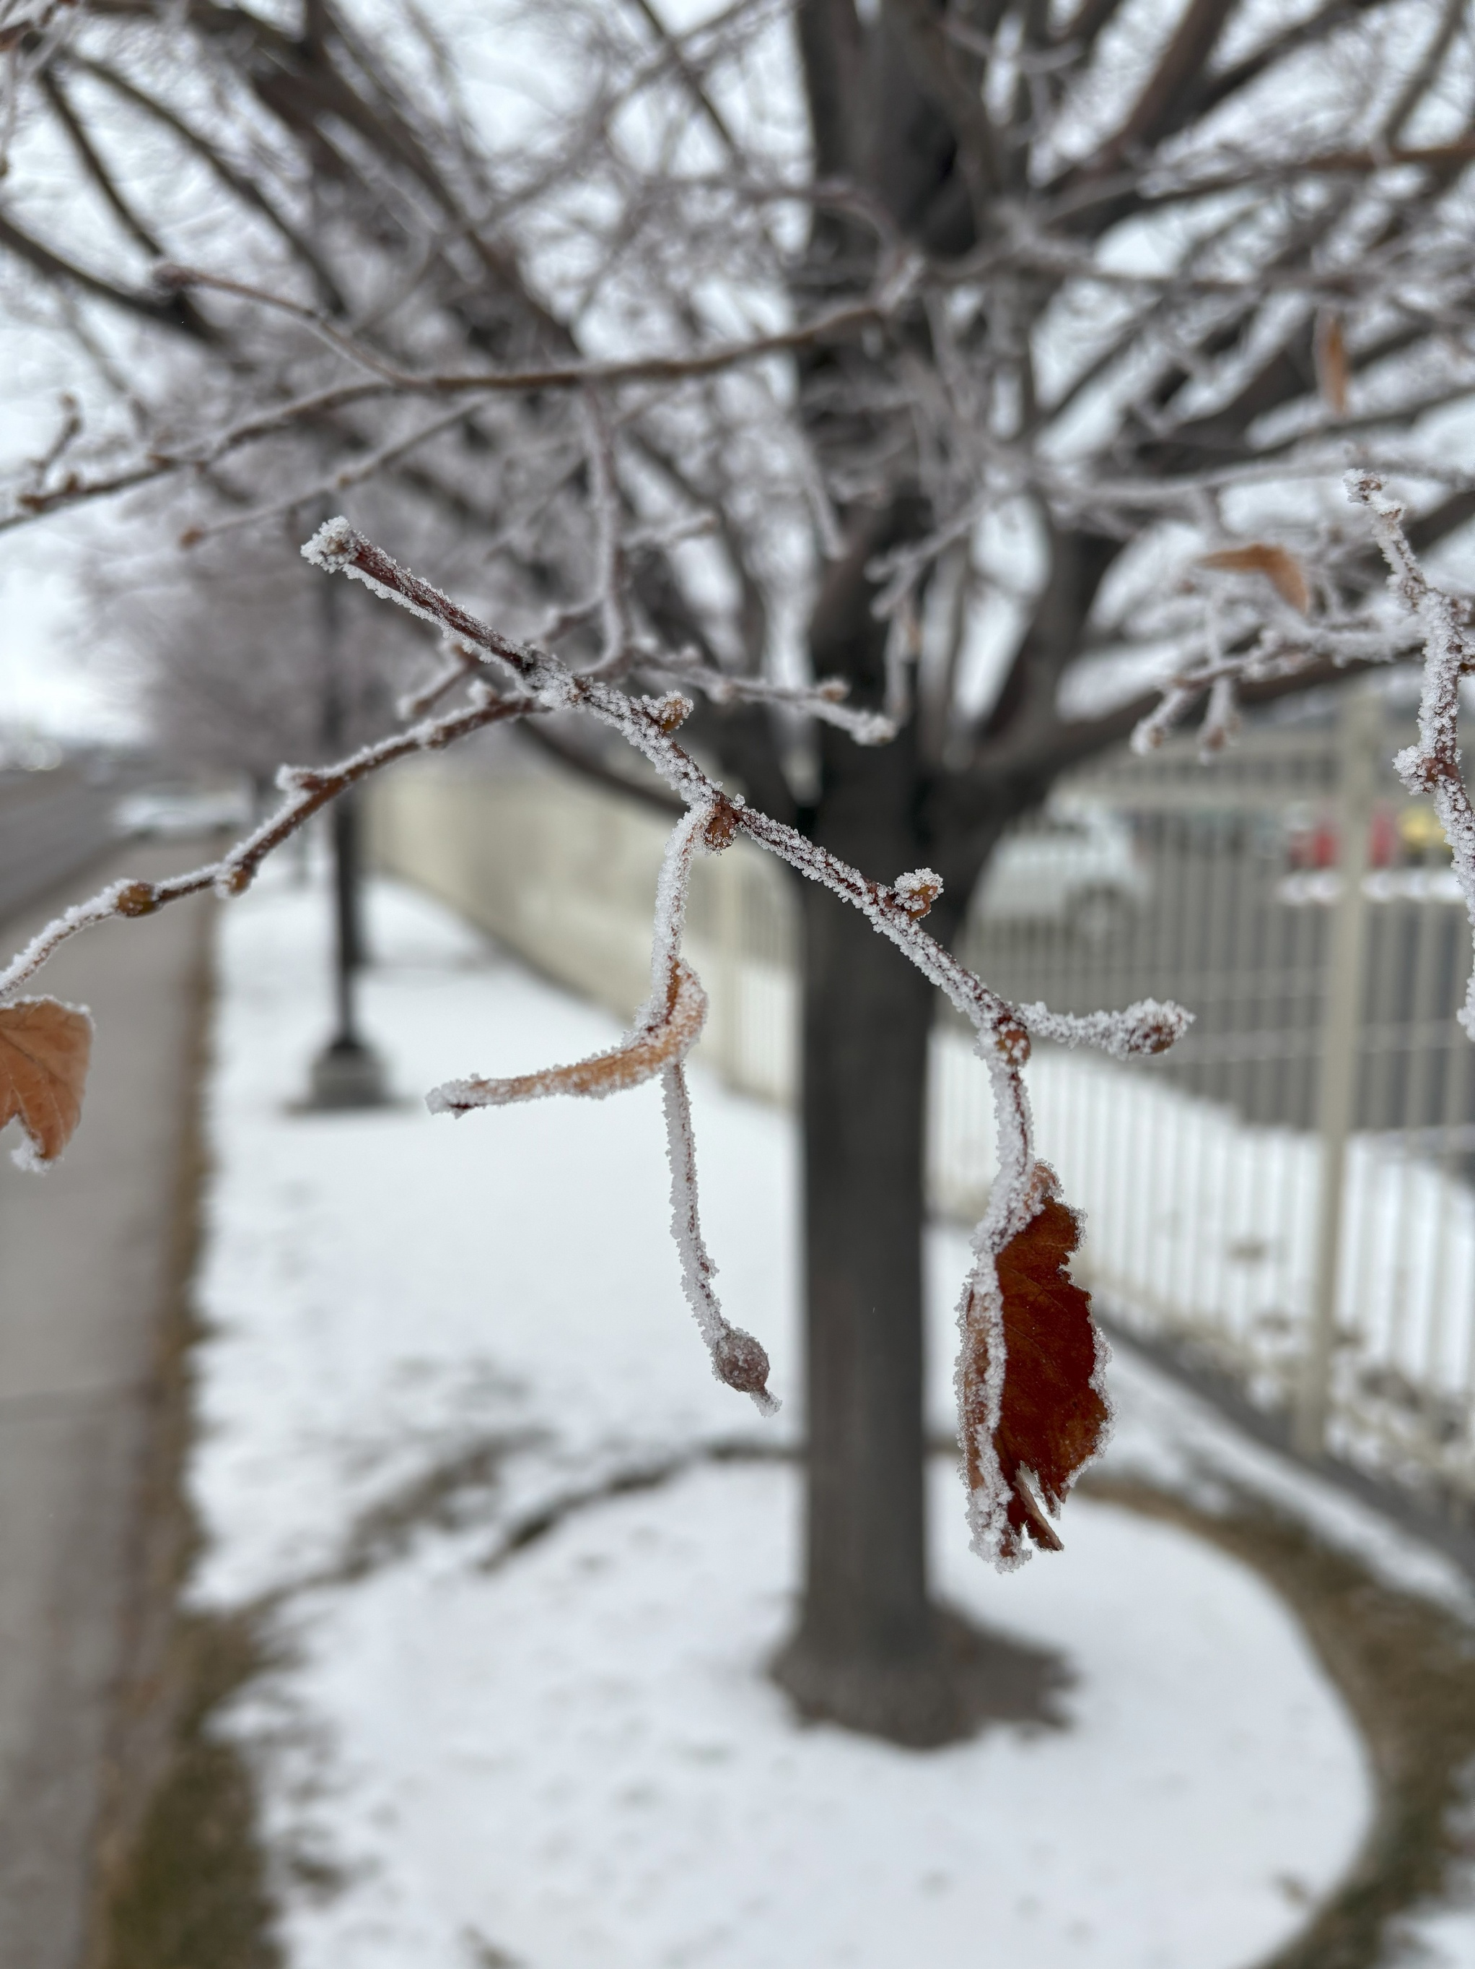
How I learn best
Starting Off Something I prefer figuring things out, I like to just get down to it and learn as I go, trial and error kind of thing. Although visuals and explanations help, I love figuring it out for myself and seeing how it works.
Type of Person I’m a hands-on type of person. Listening about something isn’t enough. I need to do it.
Cooperation When I’m learning something new, I like to learn with others, but at my own pace. Someone to discuss problems with and to teach and learn from is always nice.
[OPTIONAL IMAGE / GIF HERE]

Slide 8
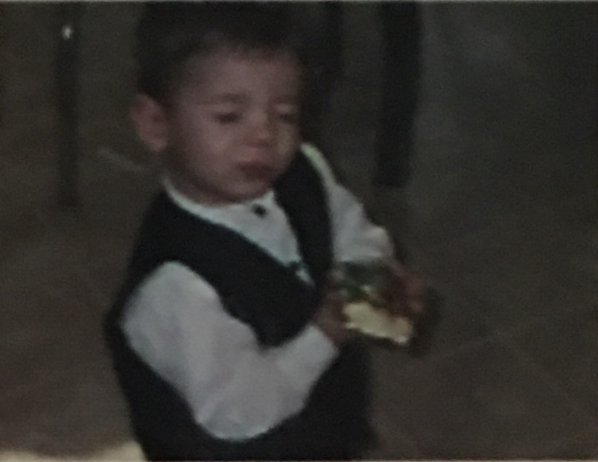
Things I struggle with
Introvert-ism I'm an introvert, so working "in the open" is fine if I have my own space to retreat to.
Discussions Too many verbal explanations and logical reasoning drains my energy
End in Mind If I don't understand the purpose or goal for which we are doing something, I find it hard to have a clear idea of the result should be.
[OPTIONAL IMAGE / GIF HERE]

Slide 9
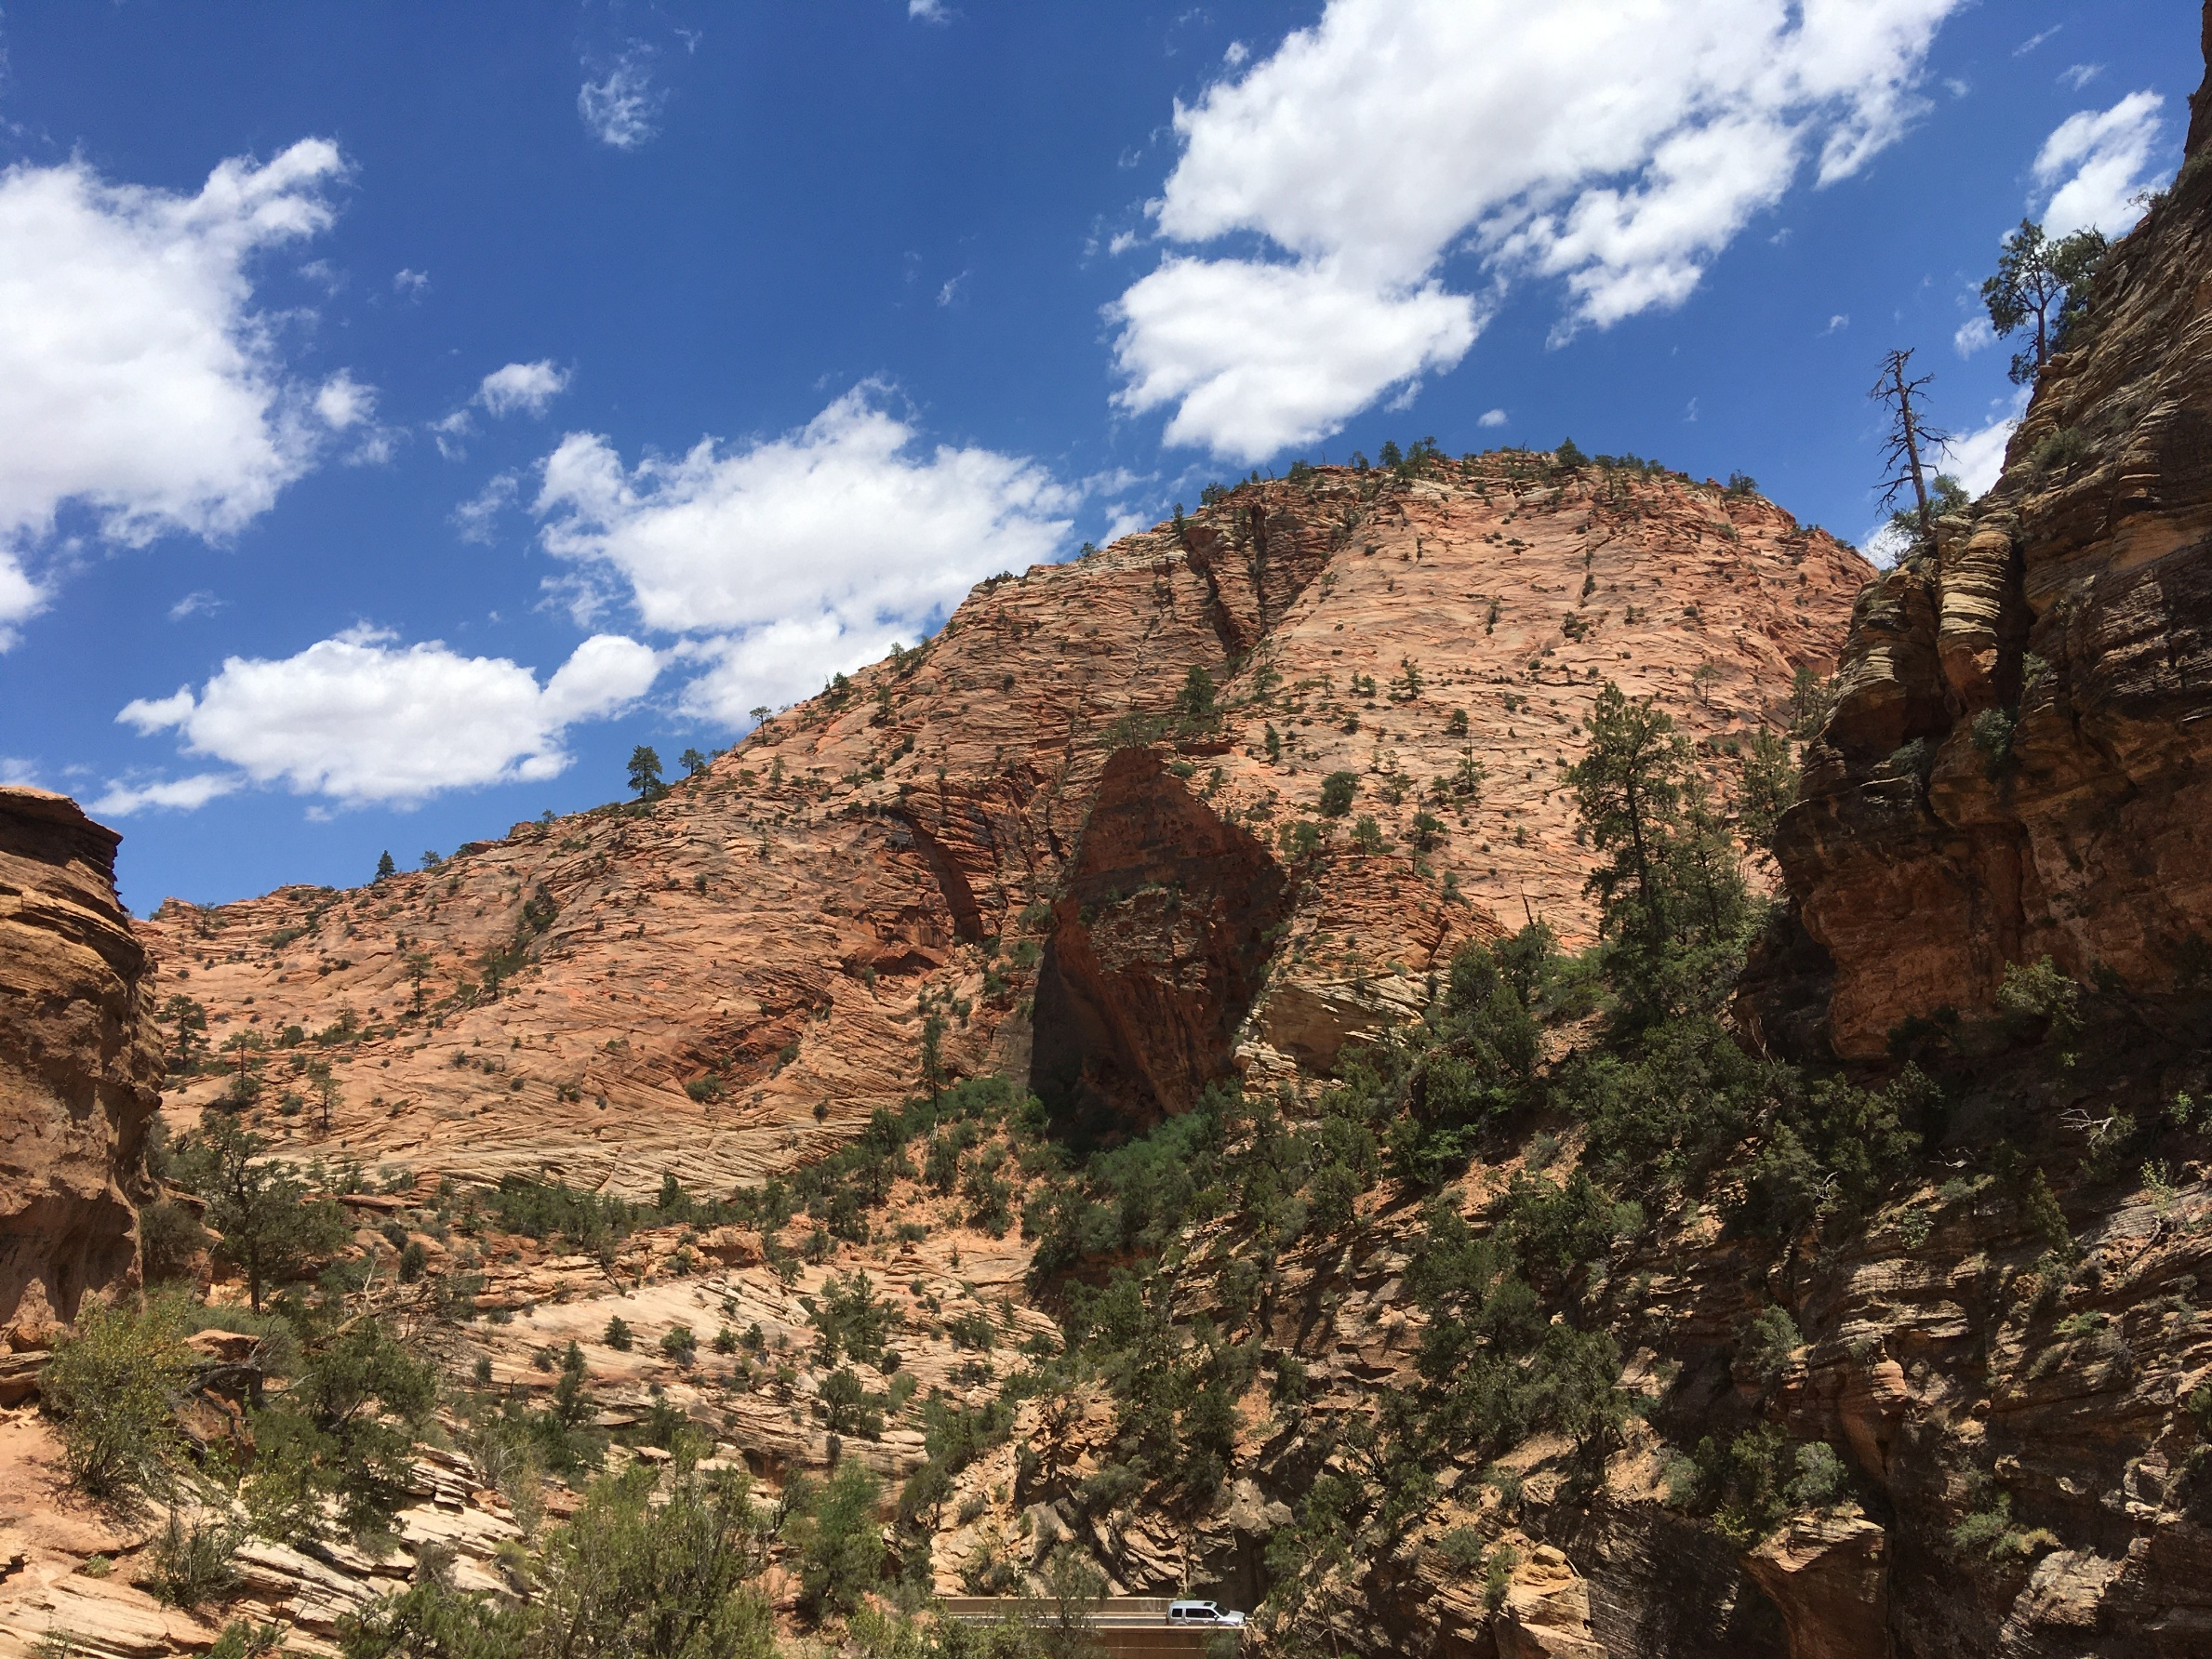
Things I love
Listening I like hearing what others are working on and how things are going in their life
Events I love organized team things – like evenings out, movie night, etc.
Activities I enjoy the outdoors, like going for a walk. Hanging out with friends, playing card or video games. Reading a good fantasy book.
[OPTIONAL IMAGE / GIF HERE]

Slide 10
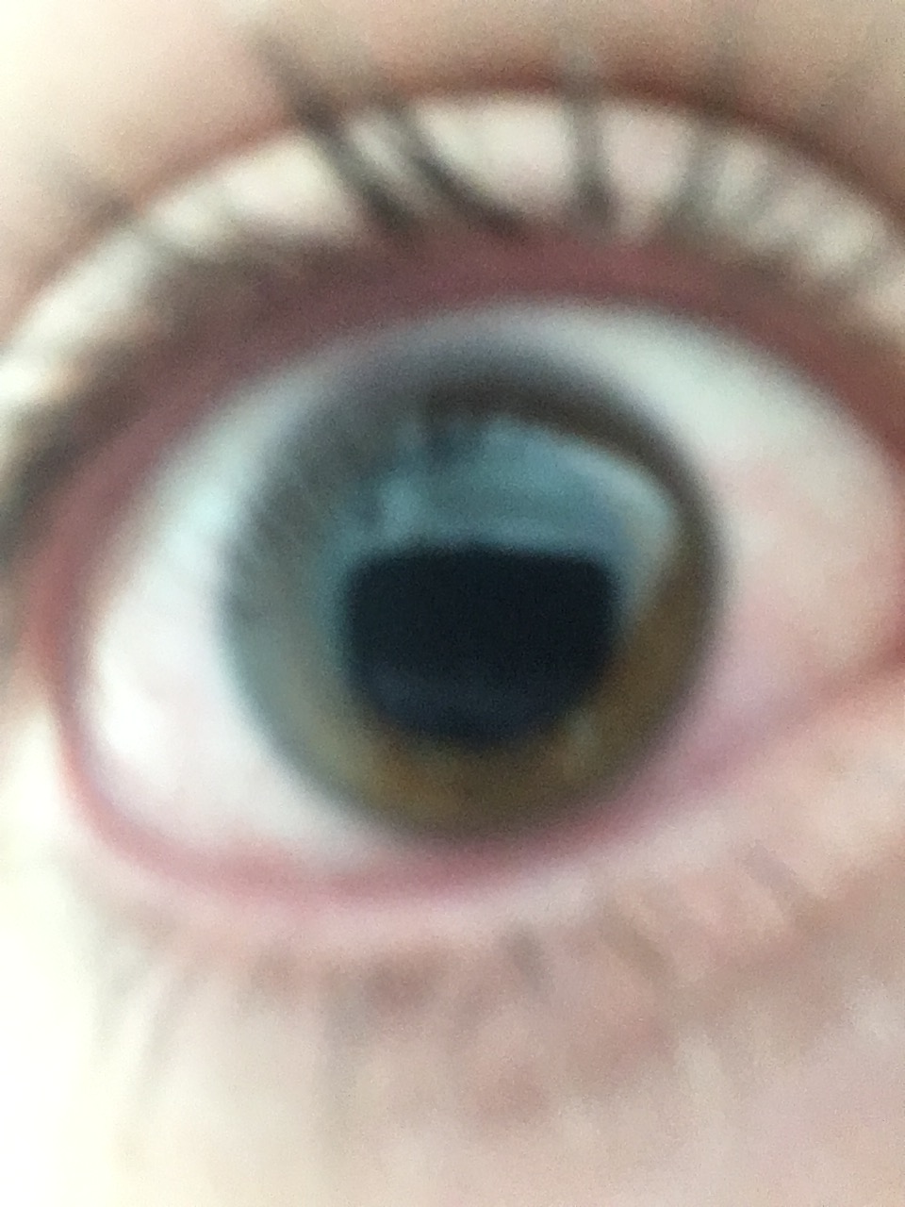
Other things to know about me
Fun Fact! If you made it this far, guess you want to know something unique about me, Fun Fact: I am blind, albeit only in my left eye.
My Tastes Food is a quick and easy way to get on my good side, and I like all food, so its very simple to do.
The Peacemaker I try my best to have a good relationship with everyone. If I look grumpy, that’s just how my normal face is, but I am just a happy person.
Interesting topics If you want, our conversations can get interesting. I go from talking about the process of overthrowing governments or debating if it’s the light or heat of fire that burns you. I am open to talk about whatever, while it is not too political or sportsy.

Slide 11
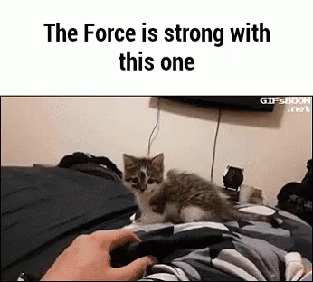

If I were an animated gif / meme / animal / song, I would be...
[ADD IMAGE / GIF HERE]
Pompeii
by Bastille

Slide 12
A mountain is hard to move as one, yet add many and it shall be done.
My favorite saying

